Slide 1
Todo: Graph emissions | Useful for observing how transport decreases emissions as these are assumptions for ct

Slide 2
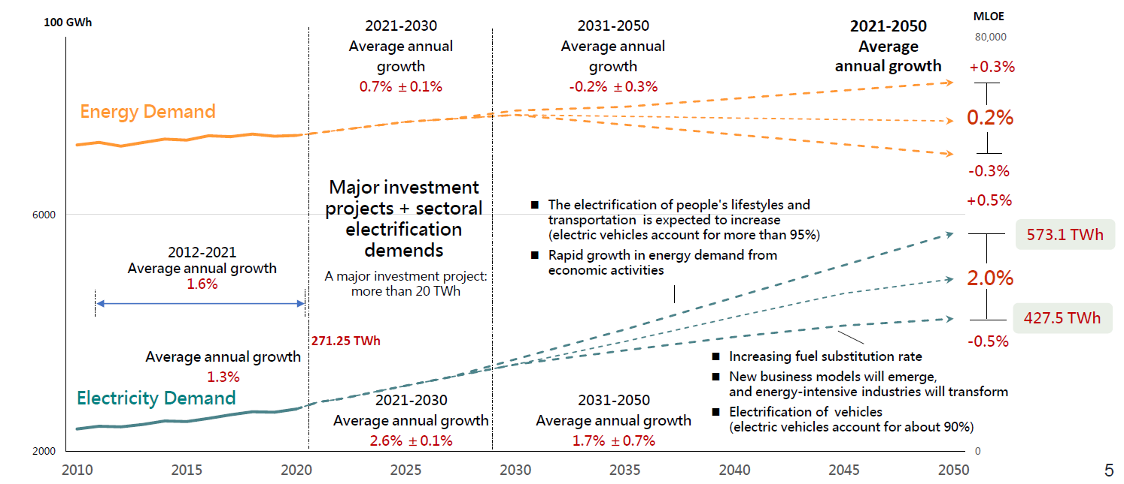
CT Government Key Regulation and Policies
2022 Net-zero roadmap

Slide 3
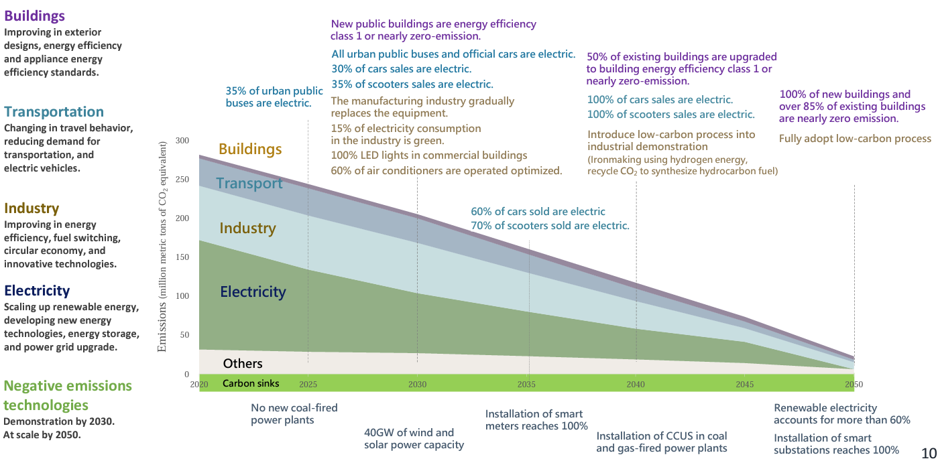
CT Government Key Regulation and Policies
2022 Net-zero roadmap

Slide 4
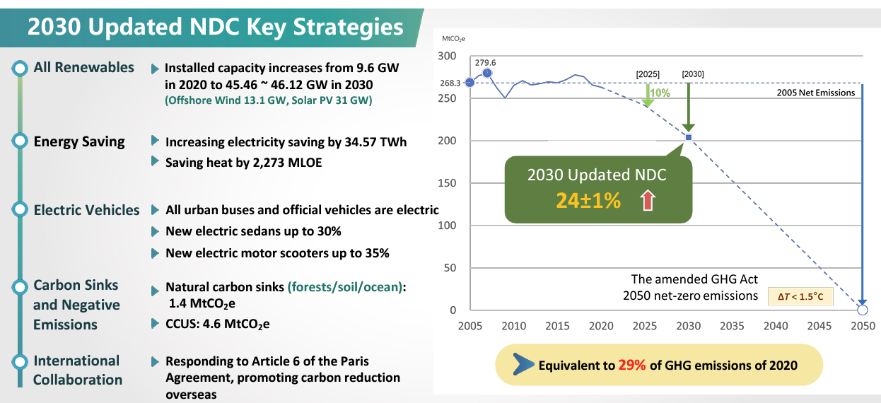
CT Government Key Regulation and Policies
2023 NDC Update (30X23~25)

Slide 5
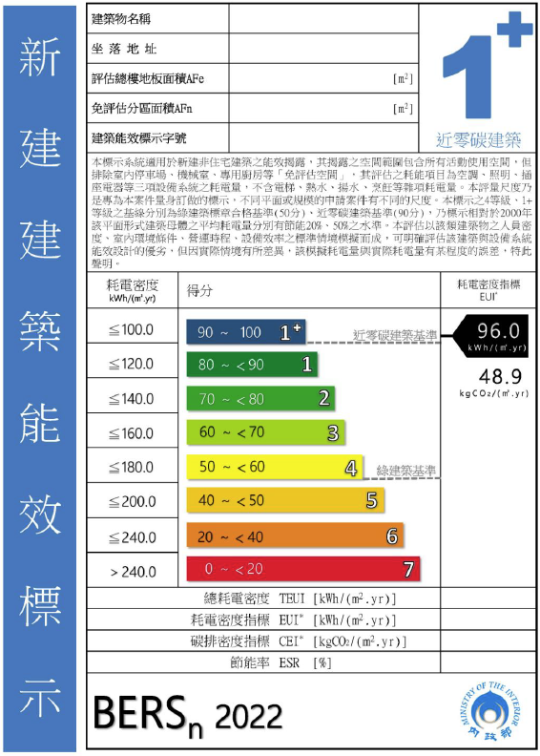
CT Government Key Regulation and Policies
12 Key Strategies for Net-zero
Industry | 50% of energy cons. of major energy users is included in ISO 50001 by 2025, 60% by 2030.
Building (Commercial) | 70% lighting are LED by 2025, 100% by 2030. 30% HVAC are optimal control by 2025, 60% by 2030. All new public building reach Level 1 or net-zero at BERS system Public building electric usage index (EUI) improve 15% from 2015 level by 2030.
Building (residential) | Residential building envelope performance increase 5% by 2025, 10% by 2030. 100% lighting on sale are LED by 2025 MEPS for Air conditioning , refrigeration are level 3 at current standards
Transport | Efficiency 2.5 tons light-duty trucks covered by energy efficiency management. Overall new transport improve energy performance by 30% Electrification 35% of city bus are eclectic-driven by 2025, 100% by 2030. 100% of government-owned vehicle are eclectic-driven by 2030 30% of vehicle on sale are eclectic-driven by 2030, 60% by 2035, 100% by 2040. 35% of scooter on sale are eclectic-driven by 2030, 70% by 2035, 100% by 2040.

